Slide 1
Pricing Portfolio Credit Derivatives Using a Simplified Dynamic Model
作者:林冠志
報告者:林弘杰

Slide 2
I.
Introduction

Slide 3
Background and Literature Review
Copula model
Dynamic model

Slide 4
Copula Model
Li (2000)
  One-factor Gaussian copula model for the case of two companies.
Gregory and Lauren (2005)
  Extend the one-factor model to the case of N companies.
t-copula, double t-copula, Clayton copula, Archimedian copula, Marshall Olkin copula

Slide 5
Copula Model
These approaches are problematic for two main reason :
  There is no dynamic consistency. These static models do not describe how the default environment evolves.
  There is no theoretical basis for the choice of any particular dependence structure.

Slide 6
Dynamic Model
Albanese et al. (2006)
Bennani (2006)
Brigo et al. (2007)
Di Graziano and Rogers (2006)
Hull and White (2007)
Schonbucher (2006)
Sidenius (2006)
Among these, the dynamic models can be categorized into three categories: structural model, top-down model and reduced-form model.

Slide 7
Dynamic Model
Structural model
  The most basic version of the structural model is similar to Gaussian copula model. Structural models have the advantage that they have sound economic fundament.
Top-down model
  The top-down model involves the development of a model for the losses on a portfolio. It models directly the cumulative portfolio loss process.

Slide 8
Dynamic Model
Reduced-form model
  The reduced-form is to specify correlated diffusion process for the hazard rates of the underlying companies.
  Hull and White (2007) develop a model that is both reduced-form and top-down. It is easy to implement and easy to calibrate to market data. Under the model the hazard rate of a company has a deterministic drift with periodic impulses. They have given examples of calibration to CDO tranche quotes with a high degree of precision.

Slide 9
Dynamic Model
This thesis modifies the model of Hull and White (2007). The objective here is to specify the procedure from model set-up calibration more completely.
This thesis adjusts some parameters to give the model more economic sense, and propose a calibration method where index tranches quotes are matched as closely as possible.

Slide 10
II.
A Primer on CDO and Index Tranche Pricing

Slide 11
Introduction on an Index Tranche
Dow Jones CDX NA IG index
  This includes 125 North American investment grad companies.
iTraxx Europe index
  This includes 125 European investment grad companies.
Index tranches of these CDS indexes are CDO tranches whose underlying portfolio is composed of the 125 companies in the CDS indexes.
For both index tranches, each company is equally weighted.
They are sliced into five tranches: equity, junior mezzanine, senior mezzanine, junior senior, super senior.

Slide 12
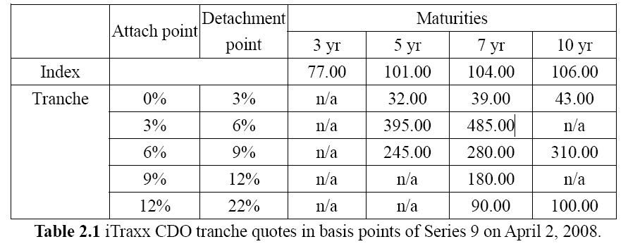
Introduction on an Index Tranche
The premium of the equity tranche includes two parts:
  The upfront percentage payment as a percentage of the notional.
  The fixed 500 basis points premium per annum.
For the nonequity tranches, their market quotes are the premium in basis points, paid quarterly in arrears to purchase protection from defaults.

Slide 13
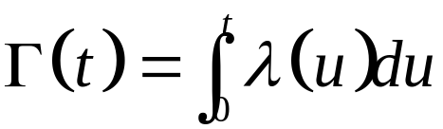
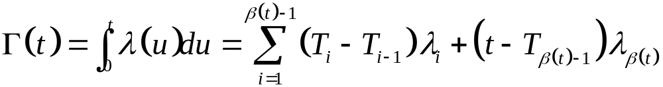
Extract Implied Default Probability from CDS Spread
The reduced-form model used here is the time-inhomogeneous Poisson process with time varying intensity λ(t) and cumulated hazard function
For calibration we will take the hazard rate to be deterministic and piecewise constant: λ(t) = λ_{i} for
t ∈[T_{i-1}, T_{i}), where T_{i} are the relevant maturities. Let β(t) be the index of the first T_{i} after t.
The cumulated hazard function is

Slide 14
Extract Implied Default Probability from CDS Spread
A typical CDS contract usually specifies two potential cash flow streams: a default leg and a premium leg.
Assumption:
  The payment on CDS is quarterly in arrears.
  R is a constant recovery rate.
  d_{i} denote the riskless discount factor from 0 to t_{i} .
  S_{CDS} is the spread for a CDS contract.
  T is the maturity year.
  τ is the time point when credit event occurring.
  Q is the probability of a credit event occurring under the risk-neutral world.

Slide 15
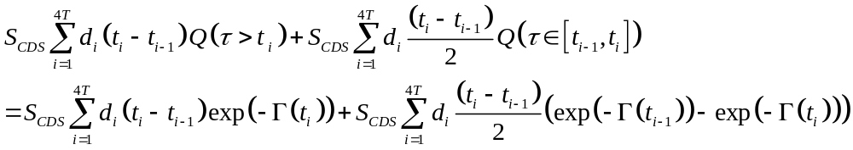
Extract Implied Default Probability from CDS Spread
The present value of default leg of a CDS is
The present value of the premium leg is

Slide 16
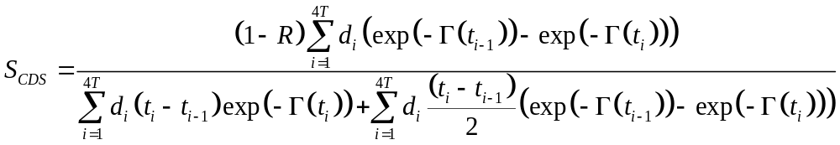
Extract Implied Default Probability from CDS Spread
The breakeven spread is

Slide 17
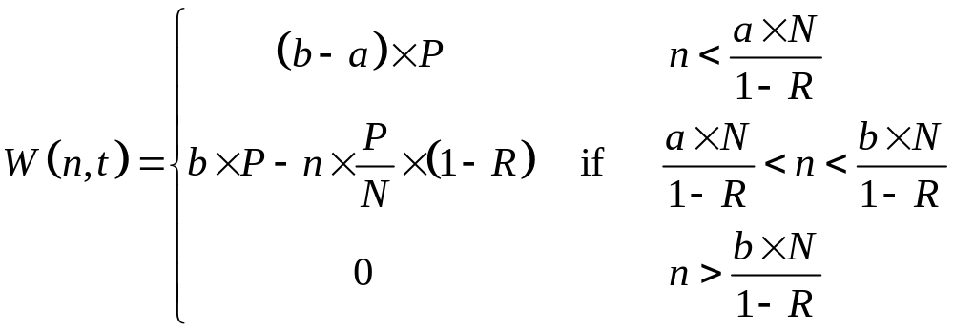
Valuation of a CDO
Assumption:
  All companies have the same notional value and same default probabilities.
  N companies in the underlying portfolio of a CDO contract.
  Total notional principal is P.
  Let a and b be the tranche attachment and detachment points.
The tranche principal at time t when there have been n defaults by

Slide 18
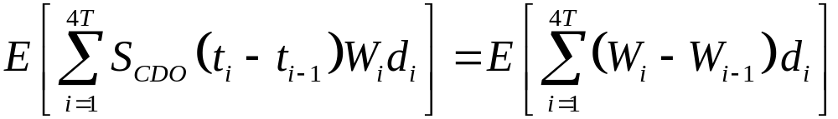
Valuation of a CDO
In general, valuation of a CDO tranche balances the expectation of the present values of the premium payments against the payoff from effective tranche losses:

Slide 19
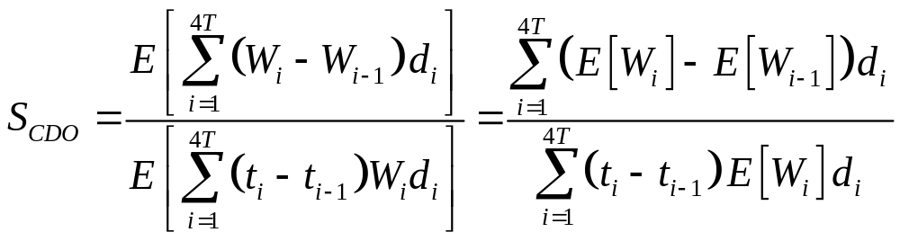
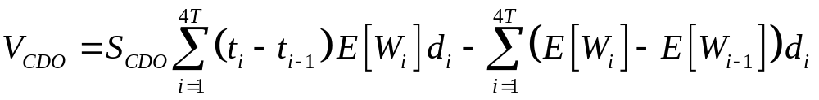
Valuation of a CDO
The breakeven spread s is given by
if the spread is set, the value of the CDO is the difference between the two legs:
The problem is reduced to the computation of the expected tranche principal, E[W_{t}], at time t.

Slide 20
III.
The Dynamic Model and Its Implementions

Slide 21
3.1 The Dynamic Model
Model Review
Model Modification

Slide 22
Model Review
Assumption:
  Periodically there are economic shocks to the default environment.
  When a shock occurs each company has a nonzero probability of default.
  These shocks and their sizes that create the default correlation.
Empirical evidence suggests that default correlations increase when hazard rates are high. So the default correlation is positively related to the default rate.

Slide 23
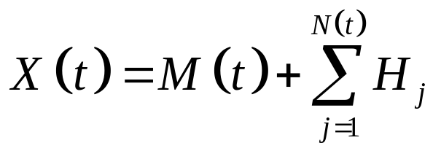
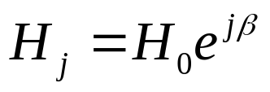
Model Review
In a risk-neutral world, Hull and White (2007) construct the model of hazard rate, X , to be one that has a deterministic drift and periodic impulses:
The number of economic shocks, N(t), is a jump process with intensity λ and jump size

Slide 24
Model Review
Hull and White (2007) first present a one-parameter model:
  The drift of the hazard rate is zero (M(t)=0).
  The jump size is constant (β=0) for any economic shock.
  The jump intensity λ(t) is time-dependent, and it is extracted from index spreads.
The only one free parameter is the implied jump size H₀ , which is calibrated to quotes of index tranches.

Slide 25
Model Review
The calibration for the original one, the three-parameter version of the model, is done in different way:
  The drift and the jump size are both nonzero.
  The jump intensity λ is assumed to be constant.
  The drift of the hazard rate is determined to match index spreads

Slide 26
Model Modification
Although the three-parameter version of the model is designed to provide a good fit to all spreads of all maturities, the calibration methods for the jump intensity of this version and the simplified one are not consistent.
The simplified version’s assumption of time-dependent jump intensity makes more economic sense.

Slide 27
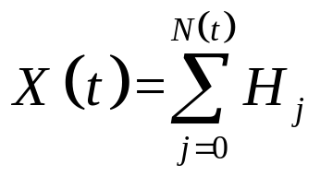
Model Modification
Using the index spread to calibrate the implied jump intensity function of the model.
The jump intensity function is based on the Poisson process.
The default is accompanied with economic shocks which create the default correlation.
The drift term to be submerged by H₀ .
Based on the above considerations, the dynamic model is

Slide 28
3.2 Three Implementations of the Model
Analytical Method
Binomial Tree Method
Monte Carlo Simulation Method

Slide 29
Analytical Method
Assumption:
  All companies have the same default probabilities.
  the default probabilities of companies are independent of one another.
  S(t) is the cumulative probability of survival by time t conditional on a particular hazard rate path between time 0 and time t.
The transformation of S(t) from X is defined by S(t)=exp(- X(t) ).

Slide 30
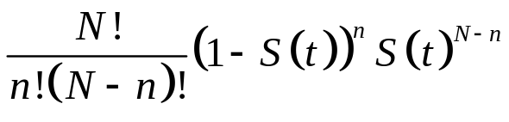
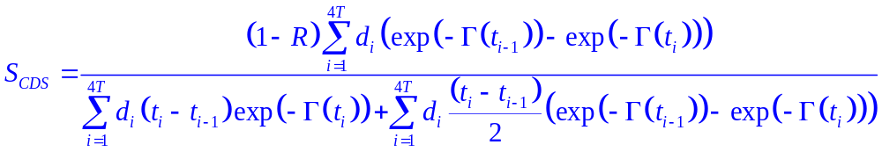
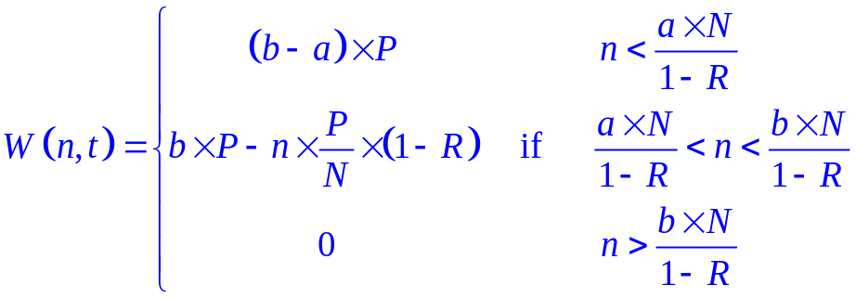
Analytical Method
If there are N companies in the portfolio, then the probability that n of them will default by time t is

Slide 31
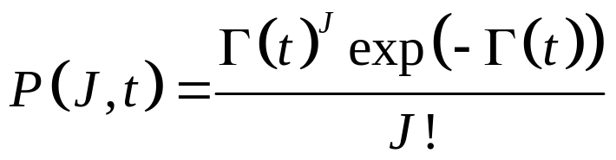
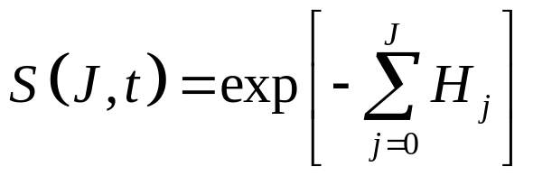
Analytical Method
The probability of J jumps between time 0 and time t:
The value of S at time t if there have been J jumps:
The probability of n defaults in the portfolio by time t conditional on J jumps is denoted by Φ(n,t|J).

Slide 32
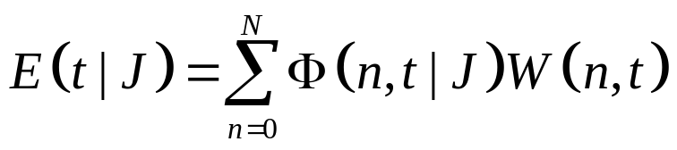
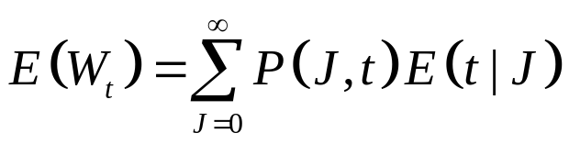
Analytical Method
The expected principal on the tranche at time t conditional on J jumps is
the unconditional expected tranche principal is
Therefore, the index tranches can be valued analytically using this dynamic model.

Slide 33
Binomial Tree Method
v is time steps between each payment date.
For every fixed positive integer m, partition the trading interval [0,T] into m=v × 4T subintervals of length h_{m}=T/m .
Denote the time corresponding to the end of the i ^{th} subinterval by τ_{i} , and let τ₀=0 . The τ_{i} are chosen so that there are nodes on each payment date.

Slide 34
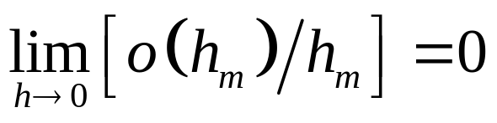
Binomial Tree Method
For the Poisson jump component, the probability of a single jump occurring in an interval of length h_{m} is equal to λh_{m}+o(h_{m}).
The probability of multiple jumps in the same interval equals o(h_{m}), where the symbol o(h_{m}) represents any function such that

Slide 35
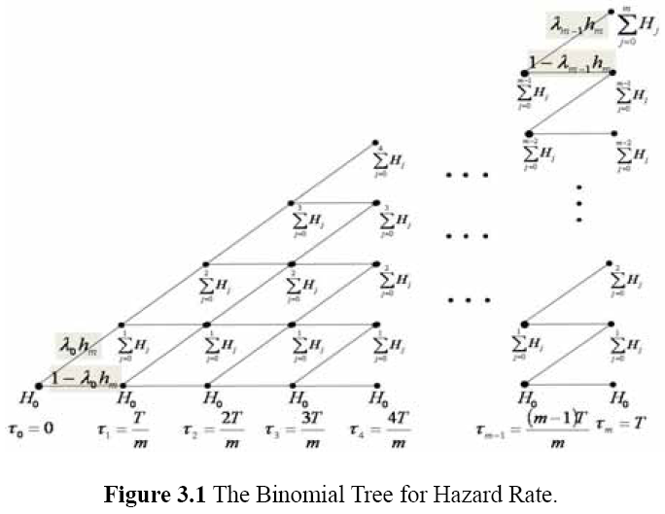
Binomial Tree Method
This thesis assume that the probability of a jump during each time interval is equal to λh_{m}, and it also assume that multiple jumps at any discrete date cannot occur.

Slide 36
Binomial Tree Method
Denote the j ^{th} node at time τ_{i} by (i,j).
S_{ij} = exp(-X_{ij})
S_{ij} can be used to calculate the value of Φ(n,τ_{i} | J).
Then we can calculate the value of W_{ij} .

Slide 37
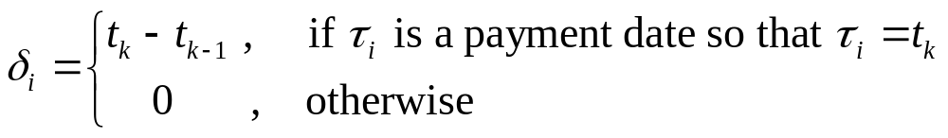
Binomial Tree Method
Let PL_{ij} and DL_{ij} be the premium leg and the default leg.
Sometimes τ_{i} correspond to payment dates and others do not.
δ_{i} is the day count factor, and
At the final nodes PL_{ij}=δ_{i}W_{ij} and DL_{ij}=0.

Slide 38
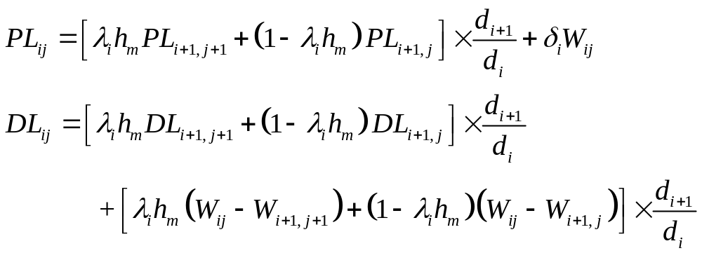
Binomial Tree Method
The finally breakeven spread of a index tranche is DL₀₀ / PL₀₀, which converges to the breakeven spread calculated by analytical method theoretically.

Slide 39
Monte Carlo Simulation Method
Calibrate the intensity function from the index spread.
Generate samples from a Poisson distribution with the corresponding intensities at each payment day.
Calculate the hazard rate and the cumulative survival probability.
Calculate the breakeven spread of index tranche are the same as the analytical method.
Repeat this simulation for one million times and calculate the average value of the breakeven spread of index tranche, which also converges to the breakeven spread calculated by analytical method theoretically.

Slide 40
IV.
Calibration and Numerical Results

Slide 41
Calibration and Numerical Results
The dynamic model is calibrated to the market quotes in Table 2.1 for iTraxx Europe Index of Series 9 observed on April 2, 2008.
All calibrations assume recovery rate, R = 40%, and the risk-free interest rate r = 5%.
Step 1:
Use the model of CDS spread to calibrate the jump intensityλ(t) to the index spread in Table 2.1.
Maturities (yr) | Maturity (date) | Index spread (bps) | Intensity
3 | 2011/4/2 | 77.00 | 1.2833%
5 | 2013/4/2 | 101.00 | 2.3937%
7 | 2015/4/2 | 104.00 | 1.8934%
10 | 2018/4/2 | 106.00 | 1.8775%
Table 4.2 Piecewise constant intensity calibrated to index spread on April 2, 2008

Slide 42
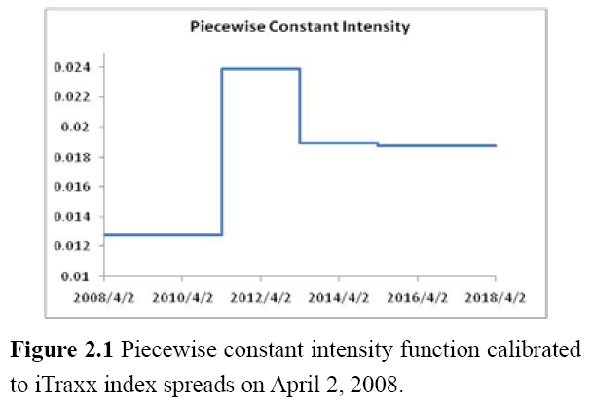
Calibration and Numerical Results
From the calibrated intensity graphs, the market perceives the second interval as the most risky, because the intensity is highest in that period.

Slide 43
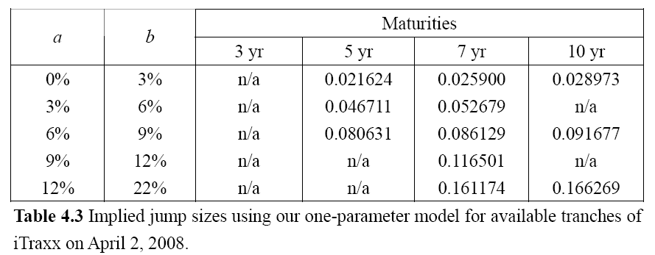
Calibration and Numerical Results
Step 2:
Calibrate the jump sizes implied from the iTraxx market quotes in Table 2.1 using the one-parameter model:

Slide 44
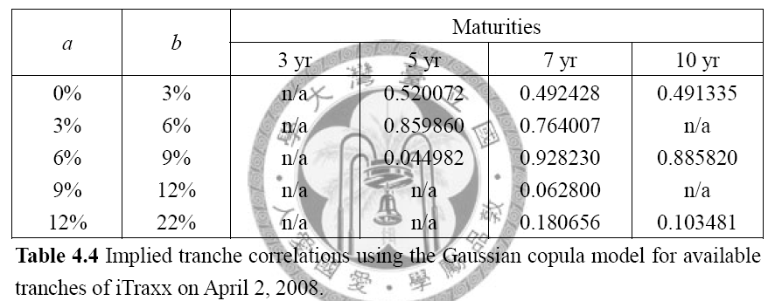
Calibration and Numerical Results
Calibrate the tranche correlations implied from the same quotes using the Gaussian copula model:

Slide 45
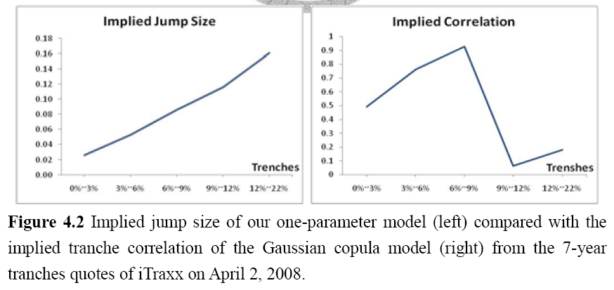
Calibration and Numerical Results
The implied jump size creates the default correlation which is positively related to the default rate.
Figure 4.2 can be seen that the two exhibit different patterns.

Slide 46
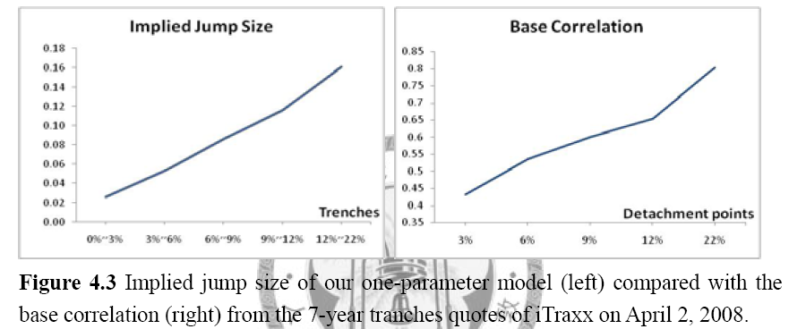
Calibration and Numerical Results
Figure 4.3 compares the jump sizes with the base correlations. The pattern of implied jump size is similar to base correlation which is much smoother and more stable.
The advantage of calculating an implied jump size rather than an implied copula correlation is that the jump size is associated with a dynamic model.
the pattern of implied jump size in our one-parameter dynamic model resembles the base correlation of the static model.

Slide 47
Calibration and Numerical Results
Step 3:
Use the optimization numerical method to calibrate the parameters H₀ and β of the two-parameter model.
That is to minimize the sum of squared differences between market tranche spreads and model tranche spreads. The procedure involves repeatedly:
  Choosing trial values of H₀ and β
  Calculating the sum of squared differences between model spreads and market spreads for all tranches of all maturities available.

Slide 48
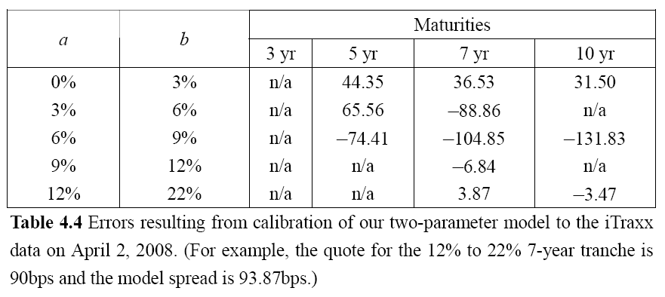
Calibration and Numerical Results
For the iTraxx data in Table 2.1 the best fit parameter values are H₀ = 0.046750 and β = 1.835630.
The pricing errors are shown in Table 4.4.
The model fits market data much better than versions of the one-parameter model.

Slide 49
Calibration and Numerical Results
Calibrating to the iTraxx data on April 2, 2008, the values of H_{j} in the two-parameter model are initially small, but increase fast; i.e, H₁ = 0.2931, H₂ =1.8373, H₃ = 11.5184. Thus the survival probability decreases fast when the economic shock increases.
There is a small probability of low values of S being reached.
This is also consistent with the original model of the results in papers such as Hull and White (2006), which show that it is necessary to assign a very low, but non-zero, probability to a very high hazard rate in a static model in order to fit market quotes.

Slide 50
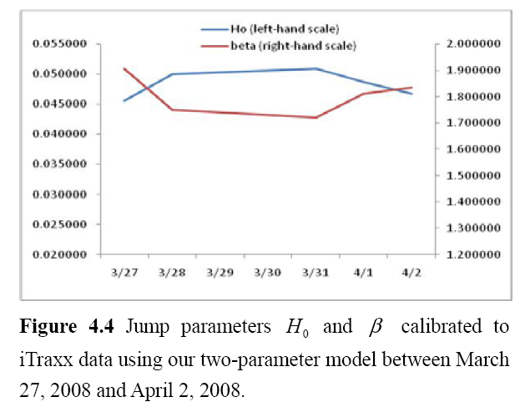
Calibration and Numerical Results
This thesis tries to observe the fluctuation of the parameters from calibrating to all the available iTraxx tranche data between March 27, 2008 and April 2, 2008.
The jump parameter values are showed in Figure 4.4

Slide 51
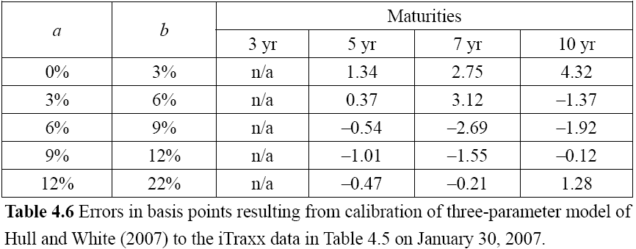
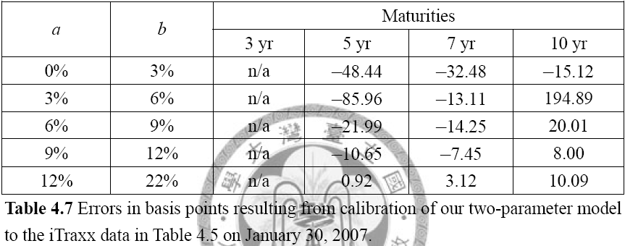
Calibration and Numerical Results
Using the original model of Hull and White (2007), the best fit parameter values of their three-parameter model are H₀=0.00223, β = 0.9329 and λ = 0.1310.
The best fit parameter values of the two-parameter model are H₀ =0.03569 and β = 1.42379.

Slide 52
Calibration and Numerical Results
It turns out that the two-parameter model is not as good as the original model of Hull and White (2007), although that model and the procedure of calibration make more economic sense.
The two-parameter model’s spreads are close to the market spreads only for some tranches, such as the 12%~22% tranche of 5-year and 7-year.
For the senior tranche of 3%~6% the model’s error is quite large.
The model of Hull and White (2007) fits market data well for almost all the tranches quotes.

Slide 53
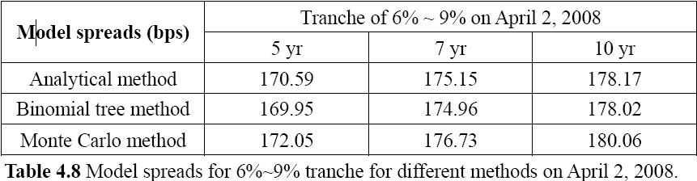
Calibration and Numerical Results
Step 4:
Use the jump parameters calibrated to the iTraxx market quotes on April 2, 2008 to compare the results of model spreads generated by the analytical method with those obtained by the binomial tree method and the Monte Carlo simulation. The results are presented in Table 4.8.

Slide 54
V.
Conclusion and Future Work

Slide 55
Conclusion and Future Work
This thesis presents a revised dynamic model based on Hull and White (2007). Their justification for the modification is that their model and way of calibration make more economic sense.
They also use the mathematical proof to support the procedure of representing the model in the form of a binomial tree.
Although the result is not well, it captures the other specificities and advantages:
  It is a dynamic model which can be represented as a binomial tree.
  It is simple and easy to implement.

Slide 56
Conclusion and Future Work
This thesis highlights further research in the future:
  Using the tree algorithm to price exotic credit portfolio derivatives.
  Developing an efficient Monte Carlo simulation whose implementation of the model can price more strongly path-dependent credit derivatives.
  Developing the revised dynamic model further to make it provide a good fit to CDO quotes of all maturities.

Slide 57
Thanks sincerely
for listening and advising

